Slide 1



3140702
Operating System
Unit – 3 & 4
Concurrency & Interprocess Communication
Prof. Firoz A. Sherasiya
9879879861
firoz.sherasiya@darshan.ac.in

Slide 2
Topics to be covered
IPC, Race Conditions, Critical Section, Mutual Exclusion
Hardware Solution
Strict Alternation
Dekker’s Algorithm
Peterson’s Solution
The Producer Consumer Problem
Semaphores
Event Counters
Monitors
Classical IPC Problems:
Reader’s & Writer Problem
Dinning Philosopher Problem
Pipes and Message Passing
Barrier and Signal

Slide 3
Inter process communication (IPC)
Processes in a system can be independent or cooperating.
Independent process cannot affect or be affected by the execution of another process.
Cooperating process can affect or be affected by the execution of another process.
Cooperating processes need inter process communication mechanisms.

Slide 4
Inter process communication (IPC)
Reasons of process cooperation
Information sharing
Computation speed-up
Modularity
Convenience
Issues of process cooperation
Data corruption, deadlocks, increased complexity
Requires processes to synchronize their processing

Slide 5
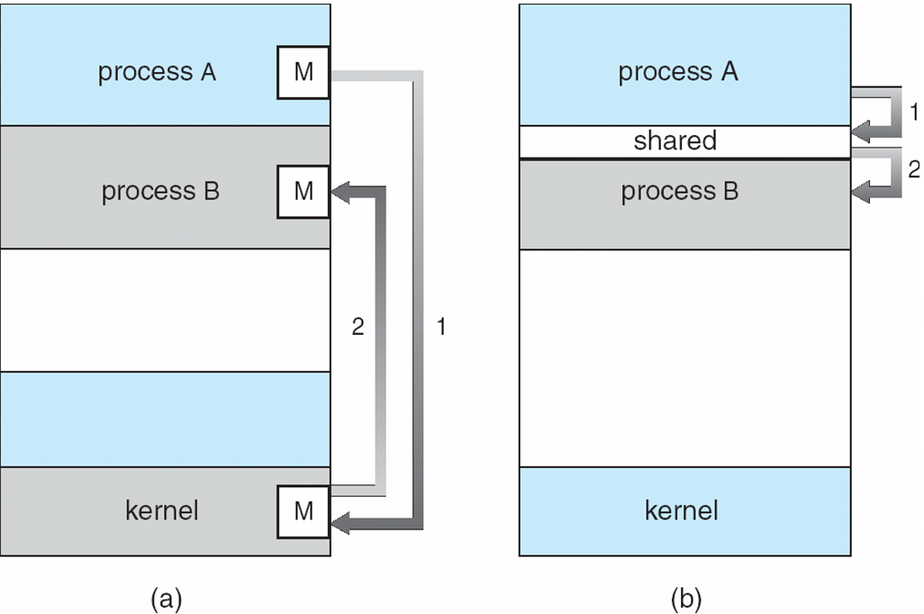
Models for Inter Process Communication (IPC)
There are two models for IPC
Message Passing (Process A send the message to Kernel and then Kernel send that message to Process B)
Shared Memory (Process A put the message into Shared Memory and then Process B read that message from Shared Memory)

Slide 6
Race Condition
Race Condition:
A race condition is an undesirable situation that occurs when a device or system attempts to perform two or more operations at the same time.
But, because of the nature of the device or system, the operations must be done in the proper sequence to be done correctly.

Slide 7
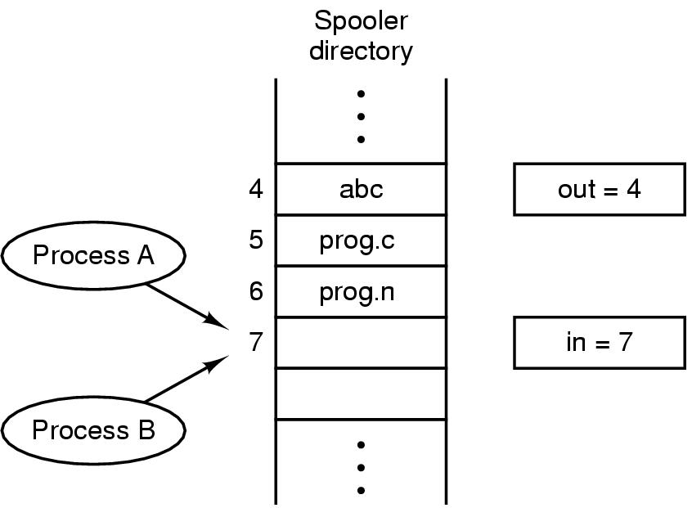
Example of Race Condition
Print spooler directory example : Two processes want to access shared memory at the same time.

Slide 8
Example of Race Condition
Process A
next_free_slot = in
Write file name at slot (7)
next_free_slot += 1
in = next_free_slot (8)
Context Switch
Process B
next_free_slot = in
Write file name at slot (8)
next_free_slot += 1
in = next_free_slot (9)
Process A
next_free_slot = in (7)
Context Switch
Process B
next_free_slot = in (7)
Write file name at slot (7)
next_free_slot += 1
in = next_free_slot (8)
Context Switch
Process A
Write file name at slot (7)
next_free_slot += 1
in = next_free_slot (8)
Race Condition

Slide 9
Basic Definitions
Race Condition: Situations like this where processes access the same data concurrently and the outcome of execution depends on the particular order in which the access takes place is called a race condition. OR
Situation where two or more processes are reading or writing some shared data and the final result depends on who runs precisely when.
Reasons for Race Condition
Exact instruction execution order cannot be predicted
Resource (file, memory, data etc…) sharing

Slide 10
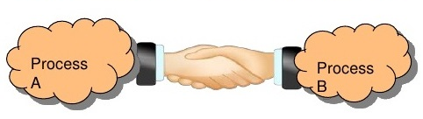
Basic Definitions
Inter Process Communication: It is a communication between two or more processes.

Slide 11
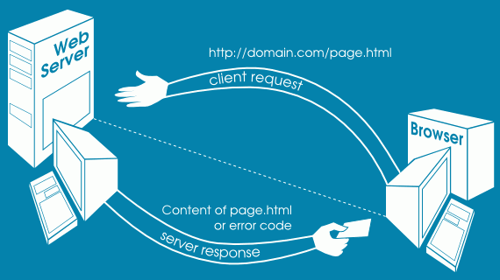
Basic Definitions
Inter Process Communication: It is a communication between two or more processes.

Slide 12



Basic Definitions
Inter Process Communication: It is a communication between two or more processes.
Send message
P1
P3
P2

Slide 13
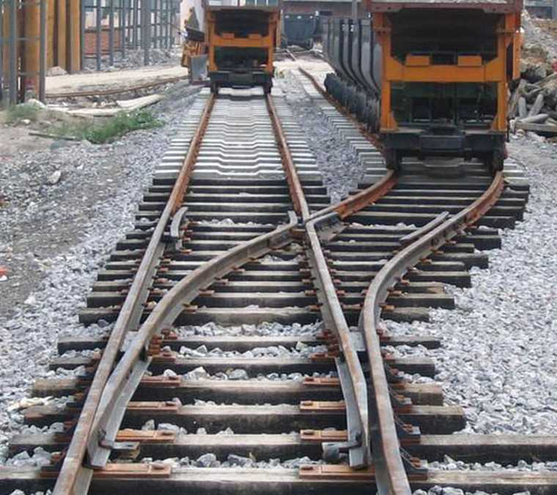
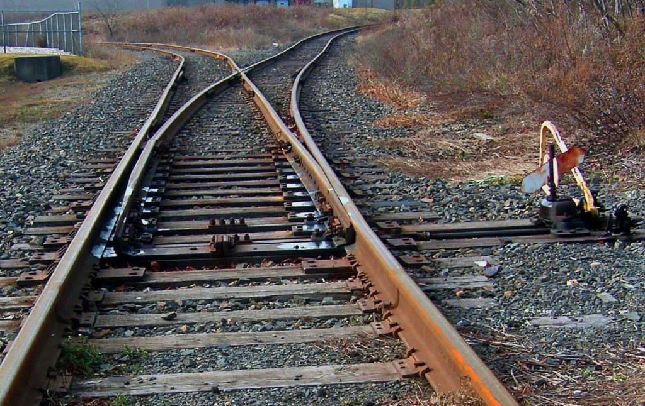
Basic Definitions
Critical Section:

Slide 14

Basic Definitions
Critical Section: The part of program where the shared resource is accessed is called critical section or critical region.
A enters in critical region
A leaves critical region
Process A
B attempt to enter
B enters in critical region
B leaves critical region
Process B
T1
T2
B Blocked
T3
T4

Slide 15

Basic Definitions
Mutual Exclusion: Way of making sure that if one process is using a shared variable or file; the other process will be excluded (stopped) from doing the same thing.

Slide 16
Solving Critical-Section Problem
Any good solution to the problem must satisfy following four conditions:
Mutual Exclusion
No two processes may be simultaneously inside the same critical section.
Bounded Waiting
No process should have to wait forever to enter a critical section.
Progress
No process running outside its critical region may block other processes.
Arbitrary Speed
No assumption can be made about the relative speed of different processes (though all processes have a non-zero speed).

Slide 17
Mutual exclusion with busy waiting
Mechanisms for achieving mutual exclusion with busy waiting
Disabling interrupts (Hardware approach)
Shared lock variable (Software approach)
Strict alteration (Software approach)
TSL (Test and Set Lock) instruction (Hardware approach)
Exchange instruction (Hardware approach)
Dekker’s solution (Software approach)
Peterson’s solution (Software approach)

Slide 18


Disabling interrupts
while (true)
{
< disable interrupts >;
< critical section >;
< enable interrupts >;
< remainder section>;
}
< critical section >
< remainder section>
< disable interrupts >
< enable interrupts >
Process A
Process B
T1
T3
T4

Slide 19
Disabling interrupts
Problems:
Unattractive or unwise to give user processes the power to turn off interrupts.
What if one of them did it (disable interrupt) and never turned them on (enable interrupt) again? That could be the end of the system.
If the system is a multiprocessor, with two or more CPUs, disabling interrupts affects only the CPU that executed the disable instruction. The other ones will continue running and can access the shared memory.

Slide 20
Shared lock variable
A shared variable lock having value 0 or 1.
Before entering into critical region a process checks a shared variable lock’s value.
If the value of lock is 0 then set it to 1 before entering the critical section and enters into critical section and set it to 0 immediately after leaving the critical section.
If the value of lock is 1 then wait until it becomes 0 by some other process which is in critical section.

Slide 21


Shared lock variable
Algorithm:
while (true)
{ < set shared variable to 1>;
< critical section >;
< set shared variable to 0>;
< remainder section>;
}
< critical section >
< remainder section>
<set lock to 1>
<set lock to 0>
Process A
Process B
T1
T3
T4

Slide 22
Shared lock variable
Problem:
If process P0 sees the value of lock variable 0 and before it can set it to 1 context switch occurs.
Now process P1 runs and finds value of lock variable 0, so it sets value to 1, enters critical region.
At some point of time P0 resumes, sets the value of lock variable to 1, enters critical region.
Now two processes are in their critical regions accessing the same shared memory, which violates the mutual exclusion condition.

Slide 23
Strict Alteration
Integer variable 'turn' keeps track of whose turn is to enter the critical section.
Initially turn=0. Process 0 inspects turn, finds it to be 0, and enters in its critical section.
Process 1 also finds it to be 0 and therefore sits in a loop continually testing 'turn' to see when it becomes 1.
Continuously testing a variable waiting for some event to appear is called the busy waiting.
When process 0 exits from critical region it sets turn to 1 and now process 1 can find it to be 1 and enters in to critical region.
In this way, both the processes get alternate turn to enter in critical region.

Slide 24
Strict Alteration (Algorithm)
Process 0 while (TRUE) { while (turn != 0) /* loop */ ; critical_region(); turn = 1; noncritical_region(); } | Process 1 while (TRUE) { while (turn != 1) /* loop */ ; critical_region(); turn = 0; noncritical_region(); }
0
0
0
1
0
0
0 enters in critical region
0 leaves critical region
Process 0
1 attempt to enter
1 enters in critical region
1 leaves critical region
1 attempt to enter
Process 1
T1
T2
1 Busy Wait
T3
T4
T5
1 Busy Wait

Slide 25
Strict Alteration (Disadvantages)
Taking turns is not a good idea when one of the processes is much slower than the other.

Slide 26
Strict Alteration (Disadvantages)
Consider the following situation for two processes P0 and P1.
P0 leaves its critical region, set turn to 1, enters non critical region.
P1 enters and finishes its critical region, set turn to 0.
Now both P0 and P1 in non-critical region.
P0 finishes non critical region, enters critical region again, and leaves this region, set turn to 1.
P0 and P1 are now in non-critical region.
0
0
0
1
0
0
1
0 enters in critical region
0 leaves critical region
Process 0
1 attempt to enter
1 enters in critical region
1 leaves critical region
Process 1

Slide 27
Strict Alteration (Disadvantages)
P0 finishes non critical region but cannot enter its critical region because turn = 1 and it is turn of P1 to enter the critical section.
Hence, P0 will be blocked by a process P1 which is not in critical region. This violates one of the conditions of mutual exclusion.
It wastes CPU time, so we should avoid busy waiting as much as we can.
0 attempt to enter
0
0
0
1
0
0
1
0 enters in critical region
0 leaves critical region
Process 0
1 attempt to enter
1 enters in critical region
1 leaves critical region
Process 1

Slide 28
TSL (Test and Set Lock) Instruction
Algorithm
enter_region: (Before entering its critical region, process calls enter_region)
TSL REGISTER,LOCK |copy lock variable to register set lock to 1
CMP REGISTER,#0 |was lock variable 0?
JNE enter_region |if it was nonzero, lock was set, so loop
RET |return to caller: critical region entered
leave_region: (When process wants to leave critical region, it calls leave_region)
MOVE LOCK,#0 |store 0 in lock variable
RET |return to caller
Register
0
Process A
Process B
T1
T3
T4

Slide 29
The TSL Instruction
Test and Set Lock Instruction
TSL REGISTER, LOCK
It reads the contents of the memory word lock into register RX and then stores a nonzero value at the memory address lock.
The operations of reading the word and storing into it are guaranteed to be indivisible—no other processor can access the memory word until the instruction is finished.
The CPU executing the TSL instruction locks the memory bus to prohibit other CPUs from accessing memory until it is done.

Slide 30
Exchange Instruction
Algorithm
enter_region: (Before entering its critical region, process calls enter_region)
MOVE REGISTER,#1 |put 1 in the register
XCHG REGISTER,LOCK |swap content of register & lock variable
CMP REGISTER,#0 |was lock variable 0?
JNE enter_region |if it was nonzero, lock was set, so loop
RET |return to caller: critical region entered
leave_region: (When process wants to leave critical region, it calls leave_region)
MOVE LOCK,#0 |store 0 in lock variable
RET |return to caller

Slide 31
Dekker’s Algorithm
variables
wants_to_enter [2]: array of 2 booleans
turn : integer
wants_to_enter[0] ← false
wants_to_enter[1] ← false
turn ← 0 // or 1
P0
P1
P0
P1
0 | 0
0

Slide 32
Dekker’s Algorithm
P0:
wants_to_enter[0] ← true
while (wants_to_enter[1])
{if (turn == 1)
{wants_to_enter[0] ← false
while (turn == 1)
{// busy wait}
wants_to_enter[0] ← true
}
}
// critical section
...
turn ← 1
wants_to_enter[0] ← false
// remainder section
P0
P1
P1:
wants_to_enter[1] ← true
while (wants_to_enter[0])
{if (turn == 0)
{wants_to_enter[1] ← false
while (turn == 0)
{// busy wait}
wants_to_enter[1] ← true
}
}
// critical section
...
turn ← 0
wants_to_enter[1] ← false
// remainder section
0 | 0
1 | 0
1
P0
P1
0 | 0

Slide 33
Dekker’s Algorithm
P0:
wants_to_enter[0] ← true
while (wants_to_enter[1])
{if (turn == 1)
{wants_to_enter[0] ← false
while (turn == 1)
{// busy wait}
wants_to_enter[0] ← true
}
}
// critical section
...
turn ← 1
wants_to_enter[0] ← false
// remainder section
P0
P1
P1:
wants_to_enter[1] ← true
while (wants_to_enter[0])
{if (turn == 0)
{wants_to_enter[1] ← false
while (turn == 0)
{// busy wait}
wants_to_enter[1] ← true
}
}
// critical section
...
turn ← 0
wants_to_enter[1] ← false
// remainder section
0 | 1
1 | 1
1
0 | 1
1
1 | 0

Slide 34
Peterson’s Solution
#define FALSE 0
#define TRUE 1
#define N 2 //number of processes
int turn; //whose turn is it?
int interested[N]; //all values initially 0 (FALSE)
void enter_region(int process)
{
int other; // number of the other process
other = 1 - process; // the opposite process
interested[process] = TRUE; // this process is interested
turn = process; // set flag
while(turn == process && interested[other] == TRUE); // wait
}
void leave_region(int process)
{
interested[process] = FALSE; // process leaves critical region
}
0
1
P0
P1
P0
P1
0 | 0
1 | 0
1
0
1 | 0
1 | 1
0
1
0 | 1

Slide 35
Priority inversion problem
Priority inversion means the execution of a high priority process/thread is blocked by a lower priority process/thread.
Consider a computer with two processes, H having high priority and L having low priority.
The scheduling rules are such that H runs first then L will run.

Slide 36


Priority inversion problem
At a certain moment, L is in critical region and H becomes ready to run (e.g. I/O operation complete).
H now begins busy waiting and waits until L will exit from critical region.
But H has highest priority than L so CPU is switched from L to H.
Now L will never be scheduled (get CPU) until H is running so L will never get chance to leave the critical region so H loops forever. This situation is called priority inversion problem.

Slide 37
Mutual Exclusion with Busy Waiting
Disabling Interrupts
is not appropriate as a general mutual exclusion mechanism for user processes
Lock Variables
contains exactly the same fatal flaw that we saw in the spooler directory
Strict Alternation
process running outside its critical region blocks other processes.
Peterson's Solution
The TSL/XCHG instruction
Both Peterson’s solution and the solutions using TSL or XCHG are correct.
Limitations:
Busy Waiting: this approach waste CPU time
Priority Inversion Problem: a low-priority process blocks a higher-priority one

Slide 38

Sleep and Wakeup
Peterson’s solution and solution using TSL and XCHG have the limitation of requiring busy waiting.
when a processes wants to enter in its critical section, it checks to see if the entry is allowed.
If it is not allowed, the process goes into a loop and waits (i.e., start busy waiting) until it is allowed to enter.
This approach waste CPU-time.

Slide 39
Sleep and Wakeup
But we have interprocess communication primitives (the pair of sleep & wakeup).
Sleep: It is a system call that causes the caller to be blocked (suspended) until some other process wakes it up.
Wakeup: It is a system call that wakes up the process.
Both 'sleep' and 'wakeup' system calls have one parameter that represents a memory address used to match up 'sleeps' and 'wakeups'.

Slide 40
Producer Consumer problem
It is multi-process synchronization problem.
It is also known as bounded buffer problem.
This problem describes two processes producer and consumer, who share common, fixed size buffer.
Producer process
Produce some information and put it into buffer
Consumer process
Consume this information (remove it from the buffer)
Producer
Buffer
Consumer

Slide 41
What Producer Consumer problem is?
The problem is to make sure that the producer won’t try to add data (information) into the buffer if it is full and consumer won’t try to remove data (information) from the an empty buffer.
Solution for producer:
Producer either go to sleep or discard data if the buffer is full.
Once the consumer removes an item from the buffer, it notifies (wakeups) the producer to put the data into buffer.
Solution for consumer:
Consumer can go to sleep if the buffer is empty.
Once the producer puts data into buffer, it notifies (wakeups) the consumer to remove (use) data from buffer.

Slide 42
What Producer Consumer problem is?
Buffer is empty
Producer want to produce
Consumer want to consume
Buffer is full
Producer want to produce
Consumer want to consume
Buffer is partial filled
Producer want to produce
Consumer want to consume
√
X
Producer
Buffer
Consumer
X
√
√
√

Slide 43
Producer Consumer problem using Sleep & Wakeup
#define N 4
int count=0;
void producer (void)
{ int item;
while (true) {
item=produce_item();
if (count==N) sleep();
insert_item(item);
count=count+1;
if(count==1) wakeup(consumer);
}
}
count
0
1
item
Item 1
Producer
Buffer
Consumer
1
2
3
4

Slide 44
Producer Consumer problem using Sleep & Wakeup
void consumer (void)
{ int item;
while (true)
{
if (count==0) sleep();
item=remove_item();
count=count-1;
if(count==N-1)
wakeup(producer);
consume_item(item);
}
}
count
0
1
item
Producer
Buffer
Consumer
1
Item 1
2
3
4

Slide 45
Problem in Sleep & Wakeup
Problem with this solution is that it contains a race condition that can lead to a deadlock. (How???)

Slide 46
Problem in Sleep & Wakeup
The consumer has just read the variable count, noticed it's zero and is just about to move inside the if block.
Just before calling sleep, the consumer is suspended and the producer is resumed.
The producer creates an item, puts it into the buffer, and increases count.
Because the buffer was empty prior to the last addition, the producer tries to wake up the consumer.
void consumer (void)
{ int item;
while (true)
{
if (count==0) sleep();
item=remove_item();
count=count-1;
if(count==N-1)
wakeup(producer);
consume_item(item);
}
}
Context Switching

Slide 47
Problem in Sleep & Wakeup
Unfortunately the consumer wasn't yet sleeping, and the wakeup call is lost.
When the consumer resumes, it goes to sleep and will never be awakened again. This is because the consumer is only awakened by the producer when count is equal to 1.
The producer will loop until the buffer is full, after which it will also go to sleep.
Finally, both the processes will sleep forever. This solution therefore is unsatisfactory.
void consumer (void)
{ int item;
while (true)
{
if (count==0) sleep();
item=remove_item();
count=count-1;
if(count==N-1)
wakeup(producer);
consume_item(item);
}
}

Slide 48
Semaphore
A semaphore is a variable that provides an abstraction for controlling the access of a shared resource by multiple processes in a parallel programming environment.
There are 2 types of semaphores:
Binary semaphores :-
Binary semaphores can take only 2 values (0/1).
Binary semaphores have 2 methods associated with it (up, down / lock, unlock).
They are used to acquire locks.
Counting semaphores :-
Counting semaphore can have possible values more than two.

Slide 49
Semaphore (cont…)
We want functions insert _item and remove_item such that the following hold:
Mutually exclusive access to buffer: At any time only one process should be executing (either insert_item or remove_item).
No buffer overflow: A process executes insert_item only when the buffer is not full (i.e., the process is blocked if the buffer is full).
No buffer underflow: A process executes remove_item only when the buffer is not empty (i.e., the process is blocked if the buffer is empty).

Slide 50
Semaphore (cont…)
We want functions insert _item and remove_item such that the following hold:
No busy waiting.
No producer starvation: A process does not wait forever at insert_item() provided the buffer repeatedly becomes full.
No consumer starvation: A process does not wait forever at remove_item() provided the buffer repeatedly becomes empty.

Slide 51
Semaphores
Two operations on semaphores are defined.
Down Operation
The down operation on a semaphore checks to see if the value is greater than 0.
If so, it decrements the value and just continues.
If the value is 0, the process is put to sleep without completing the down for the moment.
Checking the value, changing it, and possibly going to sleep, are all done as a single, indivisible atomic action.
It is guaranteed that once a semaphore operation has started, no other process can access the semaphore until the operation has completed or blocked.

Slide 52
Semaphores
Two operations on semaphores are defined.
Up Operation
The up operation increments the value of the semaphore addressed.
If one or more processes were sleeping on that semaphore, unable to complete an earlier down operation, one of them is chosen by the system (e.g., at random) and is allowed to complete its down.
The operation of incrementing the semaphore and waking up one process is also indivisible.
No process ever blocks doing an up, just as no process ever blocks doing a wakeup in the earlier model.

Slide 53
Producer Consumer problem using Semaphore
#define N 4
typedef int semaphore;
semaphore mutex=1;
semaphore empty=N;
semaphore full=0;
void producer (void)
{ int item;
while (true)
{
item=produce_item();
down(&empty);
down(&mutex);
insert_item(item);
up(&mutex);
up(&full);
}
}
mutex
1
1
0
empty
4
3
full
0
0
1
item
Item 1
Producer
Buffer
Consumer
1
2
3
4

Slide 54
Producer Consumer problem using Semaphore
void consumer (void)
{ int item;
while (true)
{
down(&full);
down(&mutex);
item=remove_item(item);
up(&mutex);
up(&empty);
consume_item(item);
}
}
mutex
1
0
1
1
1
0
empty
4
4
3
full
0
1
item
Producer
Buffer
Consumer
1
Item 1
2
3
4

Slide 55
Readers Writer problem
In the readers and writers problem, many competing processes are wishing to perform reading and writing operations in a database.
It is acceptable to have multiple processes reading the database at the same time, but if one process is updating (writing) the database, no other processes may have access to the database, not even readers.
P1
P2
P3
X
Read
Read
X
Write
Write
Write
X
X
DATABASE

Slide 56
Readers Writer problem
In the readers and writers problem, many competing processes are wishing to perform reading and writing operations in a database.
It is acceptable to have multiple processes reading the database at the same time, but if one process is updating (writing) the database, no other processes may have access to the database, not even readers.
P1
P2
P3
Read
Read
√
Read
√
Write
Write
X
X
DATABASE

Slide 57
Readers Writer problem
In the readers and writers problem, many competing processes are wishing to perform reading and writing operations in a database.
It is acceptable to have multiple processes reading the database at the same time, but if one process is updating (writing) the database, no other processes may have access to the database, not even readers.
Need to keep track of read of more than one process at a time
P1
P2
P3
Read
Read
√
Read
√
3
Reader_count
DATABASE

Slide 58
Readers Writer problem using Semaphore
typedef int semaphore;
semaphore mutex=1; //control access to reader count
semaphore db=1; //control access to database
int reader_count=0; //number of processes reading database

Slide 59
Readers Writer problem using Semaphore
void Reader (void)
{ while (true){
down(&mutex); //gain access to reader count
reader_count=reader_count+1; //increment reader counter
if(reader_count==1) //if this is first process to read DB
down(&db) //prevent writer process to access DB
up(&mutex) //allow other process to access reader_count
read_database();
down(&mutex); //gain access to reader count
reader_count=reader_count-1; //decrement reader counter
if(reader_count==0) //if this is last process to read DB
up(&db) //leave the control of DB, allow writer process
up(&mutex) //allow other process to access reader_count
use_read_data();} //use data read from DB (non-critical)
}

Slide 60
Readers Writer problem using Semaphore
void Writer (void)
{ while (true){
create_data(); //create data to enter into DB (non-critical)
down(&db); //gain access to DB
write_db(); //write information to DB
up(&db);} //release exclusive access to DB
}

Slide 61
Monitor
A higher-level synchronization primitive.
A monitor is a collection of procedures, variables, and data structures that are all grouped together in a special kind of module or package.
Processes may call the procedures in a monitor whenever they want to, but they cannot directly access the monitor’s internal data structures from procedures declared outside the monitor.

Slide 62
Monitor
Monitors have an important property for achieving mutual exclusion: only one process can be active in a monitor at any instant.
When a process calls a monitor procedure, the first few instructions of the procedure will check to see if any other process is currently active within the monitor.
If so, the calling process will be suspended until the other process has left the monitor. If no other process is using the monitor, the calling process may enter.

Slide 63
Producer Consumer problem using Monitor
The solution proposes condition variables, along with two operations on them, wait and signal.
When a monitor procedure discovers that it cannot continue (e.g., the producer finds the buffer full), it does a wait on some condition variable, full.
This action causes the calling process to block. It also allows another process that had been previously prohibited from entering the monitor to enter now.

Slide 64
Producer Consumer problem using Monitor
This other process the consumer, can wake up its sleeping partner by doing a signal on the condition variable that its partner is waiting on.
To avoid having two active processes in the monitor at the same time a signal statement may appear only as the final statement in a monitor procedure.
If a signal is done on a condition variable on which several processes are waiting, only one of them, determined by the system scheduler, is revived.

Slide 65
Producer Consumer problem using Monitor
monitor ProducerConsumer
condition full, empty;
integer count;
procedure insert (item:integer);
begin
if count=N then wait (full);
insert_item(item);
count=count+1;
if count=1 then signal (empty);
end;

Slide 66
Producer Consumer problem using Monitor
function remove:integer;
begin
if count=0 then wait (empty);
remove=remove_item;
count=count-1;
if count=N-1 then signal (full);
end;
count=0;
end monitor;

Slide 67
Producer Consumer problem using Monitor
procedure producer;
begin
while true do
begin
item=produce_item;
ProducerConsumer.insert(item);
end;
end;
procedure consumer;
begin
while true do
begin
item=ProducerConsumer.remove;
Consume_insert(item);
end;
end;

Slide 68
Producer Consumer problem using Monitor
function remove:integer;
begin
if count=0 then wait (empty);
remove=remove_item;
count=count-1;
if count=N-1 then signal (full);
end;
procedure producer;
begin
while true do
begin
item=produce_item;
ProducerConsumer.insert(item);
end;
end;
procedure consumer;
begin
while true do
begin
item=ProducerConsumer.remove;
Consume_insert(item);
end;
end;
procedure insert (item:integer);
begin
if count=N then wait (full);
insert_item(item);
count=count+1;
if count=1 then signal (empty);
end;

Slide 69
Mutex
Mutex is the short form for ‘Mutual Exclusion Object’.
A Mutex and the binary semaphore are essentially the same.
Both Mutex and the binary semaphore can take values: 0 or 1.
mutex_lock:
TSL REGISTER,MUTEX |copy Mutex to register and set Mutex to 1
CMP REGISTERS, #0 |was Mutex zero?
JZE ok |if it was zero, Mutex was unlocked, so return
CALL thread_yield |Mutex is busy; schedule another thread
JMP mutex_lock |try again later
ok: RET |return to caller; critical region entered
mutex_unlock:
MOVE MUTEX,#0 |store a 0 in Mutex
RET |return to caller

Slide 70

Pipes
Pipe is a communication medium between two or more related or interrelated processes usually between parent and child process.
Communication is achieved by one process write into the pipe and other process reads from the pipe.
It performs one-way communication only means we can use a pipe such that one process write into the pipe, and other process reads from the pipe.
It opens a pipe, which is an area of main memory that is treated as a “virtual file”.
It is bounded buffer means we can send only limited data through pipe.

Slide 71
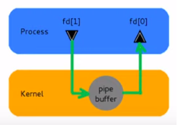
Pipes
Accessed by two associated file descriptors:
fd[0] for reading from pipe
fd[1] for writing into the pipe

Slide 72
Pipes
This system call would create a pipe for one-way communication i.e., it creates two descriptors, first one is connected to read from the pipe and other one is connected to write into the pipe.
Descriptor pipedes[0] is for reading and pipedes[1] is for writing. Whatever is written into pipedes[1] can be read from pipedes[0].
This call would return zero on success and -1 in case of failure.
#include<unistd.h>
int pipe(int pipedes[2]);

Slide 73
Pipes
#include<unistd.h>
#include<fcntl.h>
#include<stdion.h>
char *message = “Hey how are you” /* Message created */
main ()
{
char buffer[1024]; /* Size of buffer is 1024 */
int fd[2]; /* Created array of size 2 for 2 process (file descriptor) */
pipe(fd); /* Created pipe; passed array (fd) in pipe system call */
if (fork() != 0) /* Parent code */
{ write (fd[1], message, strlen (message) + 1); }
else /* Child code */
{ read (fd[0], buffer, 1024);
printf (“Received from Parent %s\n”, buffer); }
}
Header files

Slide 74
Pipes
#include<unistd.h>
#include<fcntl.h>
#include<stdion.h>
char *message = “Hey how are you”
main ()
{
char buffer[1024];
int fd[2];
pipe(fd);
if (fork() != 0) /* Parent code */
{ write (fd[1], message,
strlen (message) + 1); }
else /* Child code */
{ read (fd[0], buffer, 1024);
printf (“Received from Parent %s\n”,
buffer); }
}
#include<unistd.h>
#include<fcntl.h>
#include<stdion.h>
char *message = “Hey how are you” main ()
{
char buffer[1024];
int fd[2];
pipe(fd);
if (fork != 0) /* Parent code */
{ write (fd[1], message,
strlen (message) + 1); }
else /* Child code */
{ read (fd[0], buffer, 1024);
printf (“Received from Parent %s\n”,
buffer); }
}
Parent process
Child process
pid = 3000
3000
0

Slide 75
Message Passing
This method will use two primitives
Send: It is used to send message.
Send (destination, &message)
In above syntax destination is the process to which sender want to send message and message is what the sender wants to send.
Receive: It is used to receive message.
Receive (source, &message)
In above syntax source is the process that has send message and message is what the sender has sent.

Slide 76
Producer Consumer problem using message passing
#define N 100 //number of slots in buffer
void producer (void)
{
int item;
message m; //message buffer
while (true)
{
item=produce_item(); //generate something to put in buffer
receive(consumer, &m); //wait for an empty to arrive
build_message(&m, item); //construct a message to send
send(consumer, &m); //send item to consumer
}
}

Slide 77
Producer Consumer problem using message passing
void consumer (void)
{
int item, i;
message m;
for (i=0; i<N; i++) send (producer, &m);//send N empties
while (true)
{
receive (producer, &m); //get message containing item
item=extract_item(&m); //extract item from message
send (producer, &m); //send back empty reply
consume_item (item); //do something with the item
}
}

Slide 78
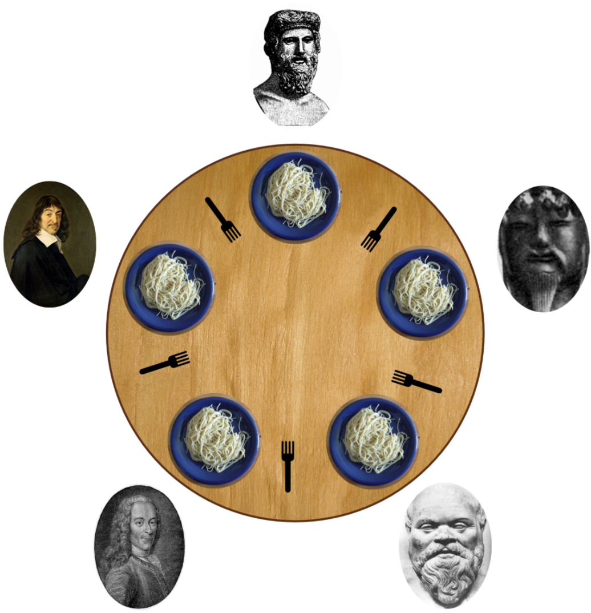
Dinning Philosopher Problem
In this problem 5 philosophers sitting at a round table doing 2 things eating and thinking.
While eating they are not thinking and while thinking they are not eating.
Each philosopher has plates that is total of 5 plates.
And there is a fork place between each pair of adjacent philosophers that is total of 5 forks.
Each philosopher needs 2 forks to eat and each philosopher can only use the forks on his immediate left and immediate right.

Slide 79
Solution to Dinning Philosopher Problem
#define N 5 //no. of philosophers
#define LEFT (i+N-1)%5 //no. of i’s left neighbor
#define RIGHT (i+1)%5 //no. of i’s right neighbor
#define THINKING 0 //Philosopher is thinking
#define HUNGRY 1 //Philosopher is trying to get forks
#define EATING 2 //Philosopher is eating
typedef int semaphore; //semaphore is special kind of int
int state[N]; //array to keep track of everyone’s state
semaphore mutex=1; //mutual exclusion for critical region
semaphore s[N]; //one semaphore per philosopher

Slide 80
Solution to Dinning Philosopher Problem
void philosopher (int i) //i: philosopher no, from 0 to N-1
{
while (true)
{
think(); //philosopher is thinking
take_forks(i); //acquire two forks or block
eat(); //eating spaghetti
put_forks(i); //put both forks back on table
}
}
void test (i) //i: philosopher no, from 0 to N-1
{
if (state[i]==HUNGRY &&
state[LEFT]!=EATING &&
state[RIGHT]!=EATING)
{
state[i]=EATING;
up (&s[i]);
}
}
void take_forks (int i) //i: philosopher no, from 0 to N-1
{
down(&mutex); //enter critical region
state[i]=HUNGRY; //record fact that philosopher i is hungry
test(i); //try to acquire 2 forks
up(&mutex); //exit critical region
down(&s[i]); //block if forks were not acquired
}
void put_forks (int i) //i: philosopher no, from 0 to N-1
{ down(&mutex); //enter critical region
state[i]=THINKING; //philosopher has finished eating
test(LEFT); //see if left neighbor can now eat
test(RIGHT); // see if right neighbor can now eat
up(&mutex); // exit critical region
}

Slide 81
Solution to Dinning Philosopher Problem
void take_forks (int i) //i: philosopher no, from 0 to N-1
{
down(&mutex); //enter critical region
state[i]=HUNGRY; //record fact that philosopher i is hungry
test(i); //try to acquire 2 forks
up(&mutex); //exit critical region
down(&s[i]); //block if forks were not acquired
}
void put_forks (int i) //i: philosopher no, from 0 to N-1
{
down(&mutex); //enter critical region
state[i]=THINKING; //philosopher has finished eating
test(LEFT); //see if left neighbor can now eat
test(RIGHT); //see if right neighbor can now eat
up(&mutex); //exit critical region
}

Slide 82
Solution to Dinning Philosopher Problem
void test (i) //i: philosopher no, from 0 to N-1
{
if (state[i]==HUNGRY &&
state[LEFT]!=EATING &&
state[RIGHT]!=EATING)
{
state[i]=EATING;
up (&s[i]);
}
}

Slide 83
Barrier
In this mechanism some application are divided into phases and have that rule that no process may proceed into the next phase until all process completed in this phase and are ready to proceed to the next phase.
This behaviour is achieved by placing barrier at the end of each phase.
When a process reaches the barrier, it is blocked until all processes have reach at the barrier.
There are four processes with a barrier.
A
B
Barrier
C
D
Time

Slide 84
Barrier
Processes A, B and D are completed and process C is still not completed so until process C will complete, process A, B and D will not start in next phase.
A
B
Barrier
C
D
Time

Slide 85
Barrier
Once process C completes all the process start in next phase.
A
B
Barrier
C
D
Time

Slide 86
Signal
Signals are software interrupts sent to a program to indicate that an important event has occurred.
When a signal is delivered to a process, the process will stop what its doing, either handle or ignore the signal.
Signals are similar to interrupts, the difference being that interrupts are mediated by the processor and handled by the kernel while signals are mediated by the kernel (possibly via system calls) and handled by processes.
The kernel may pass an interrupt as a signal to the process that caused it (examples are SIGSEGV, SIGBUS, SIGILL and SIGFPE).

Slide 87
Questions asked in GTU
Define following Terms: Mutual Exclusion, Critical Section, Race Condition
What is Semaphore? Give the implementation of Readers-Writers Problem using Semaphore
What is Semaphore? Give the implementation of Bounded Buffer Producer Consumer Problem using Semaphore.
Explain Dining philosopher solution using Semaphore.
What Critical section Problem and list the requirements to solve it. Write Peterson’s Solution for the same.
Explain Dining philosopher solution using Monitors.

Slide 88


